Slide 1

PHS650: Rigor and Reproducibility in the Social, Behavioral, and Population Health Sciences
Dr. Katherine Schaumberg
Wk 1 – Lecture 1: Intro

Slide 2
Week 1: The movement towards ‘Open Science’
Rigor: utilization of standards to ensure accuracy and truth of inferences (experimental method).
Reproducibility: info and methods that increase likelihood of independent replication
The ‘replication crisis,’ beginning in 2010s social psychology, identified failure to replicate many key findings in the scientific literature.

Slide 3



Week 2: Intro to Open Science Tools

Slide 4
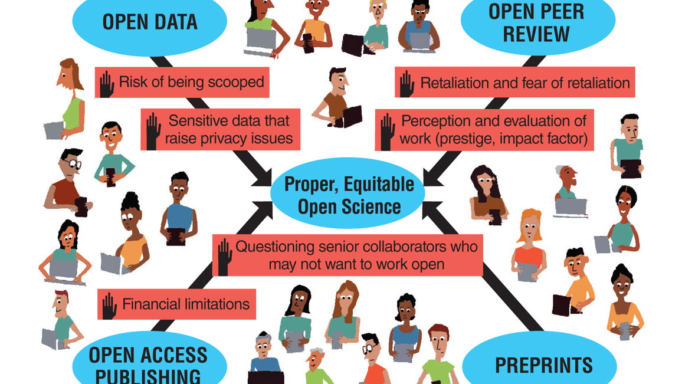
Week 3: OS Barriers and Solutions

Slide 5

Week 4: Documentation and Metadata

Slide 6
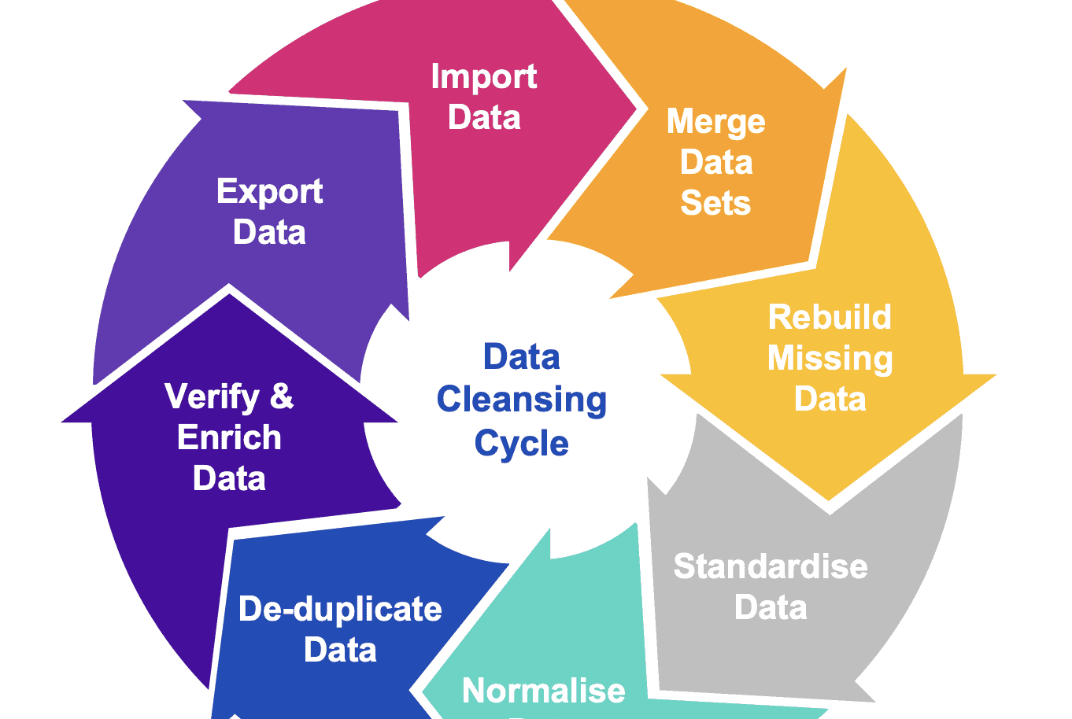
Week 5: Data Cleaning

Slide 7
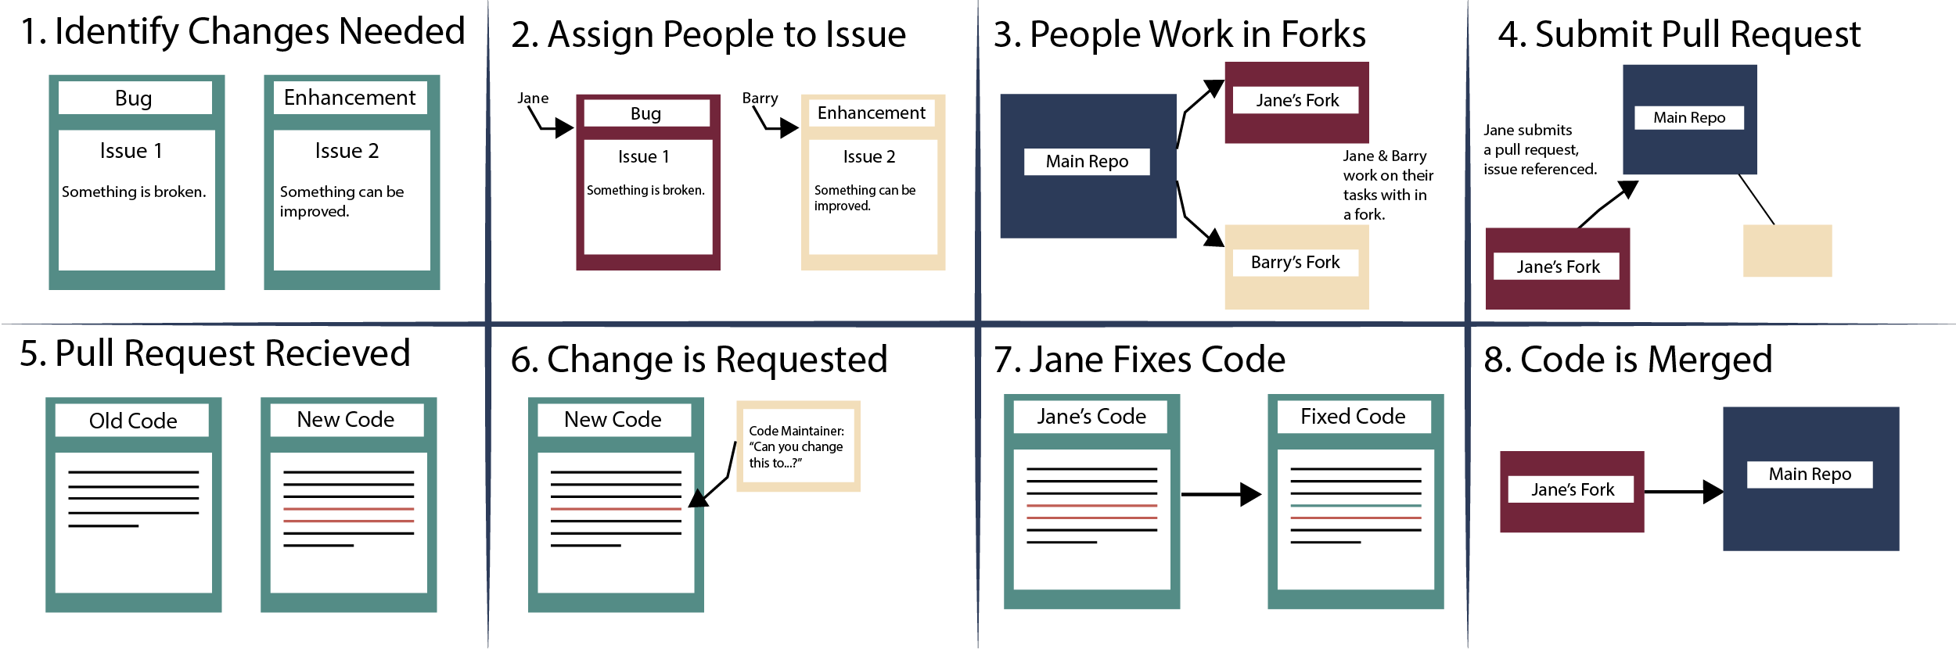
Week 6: Data Sharing and Code Collaboration

Slide 8
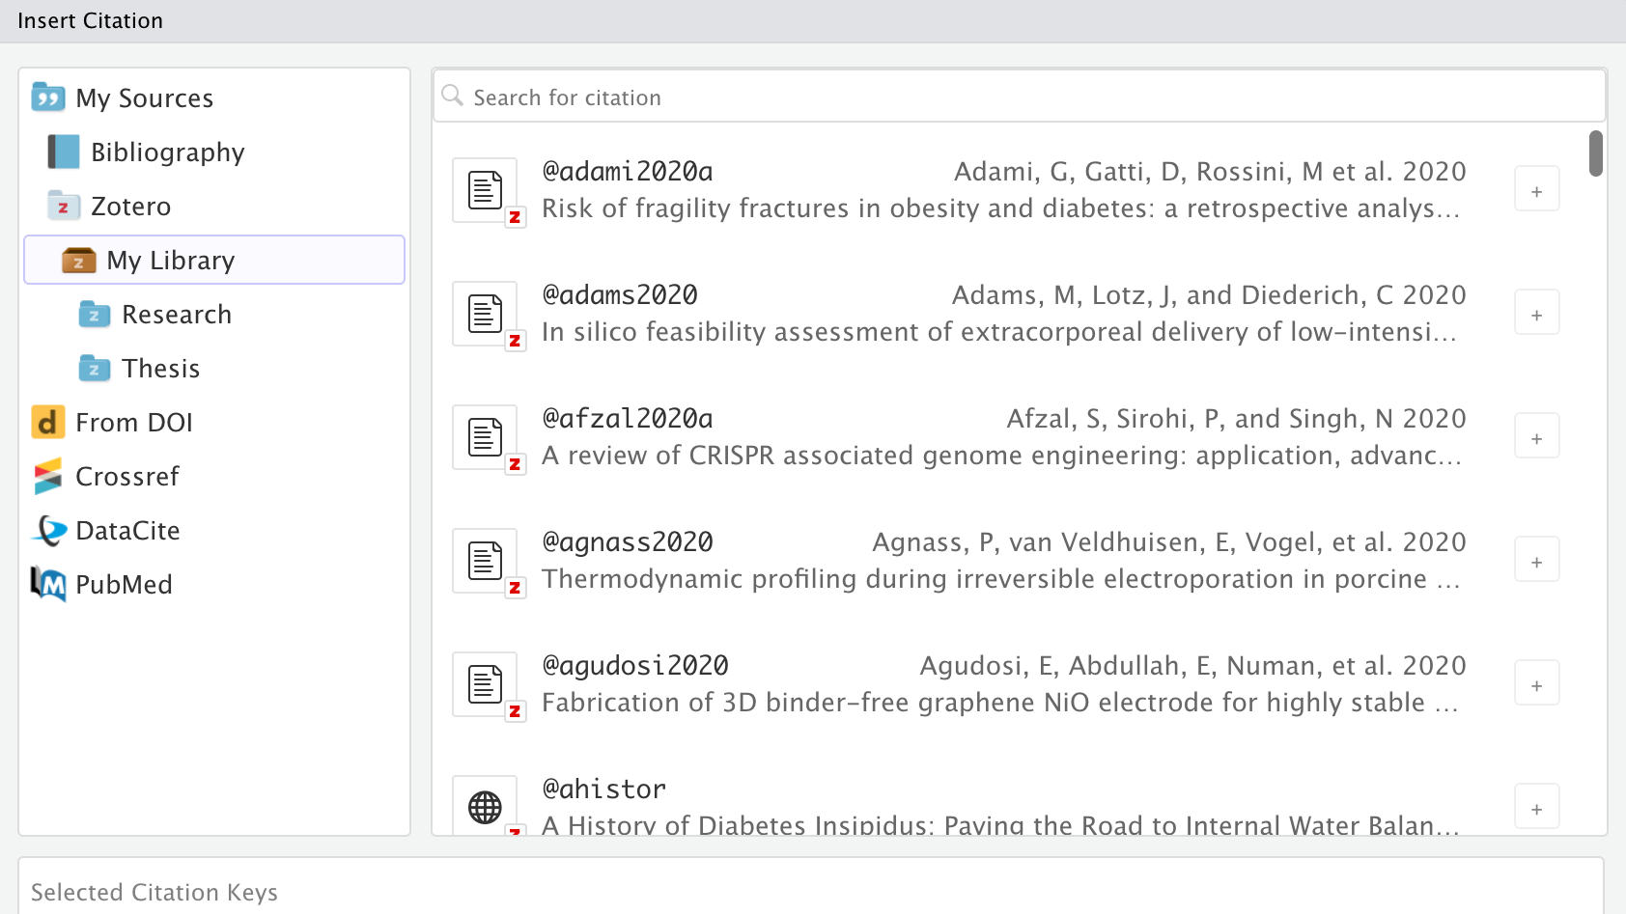
Week 7: Scientific Authoring in Quarto
+

Slide 9

Week 8: Putting it together

Slide 10
Getting Started
Register for a GitHub account and install git (see syllabus)
Install the latest version of R and RStudio

Slide 11

Assignments
Readings and Journal Discussions (30%)
Sign-up
Weekly Homework (Due Fri at 11:59p CST) (40%)
OSF pre-registration (10%)
Final Paper (30%)

Slide 12
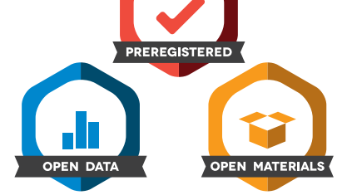
Why Open Science?

Slide 13
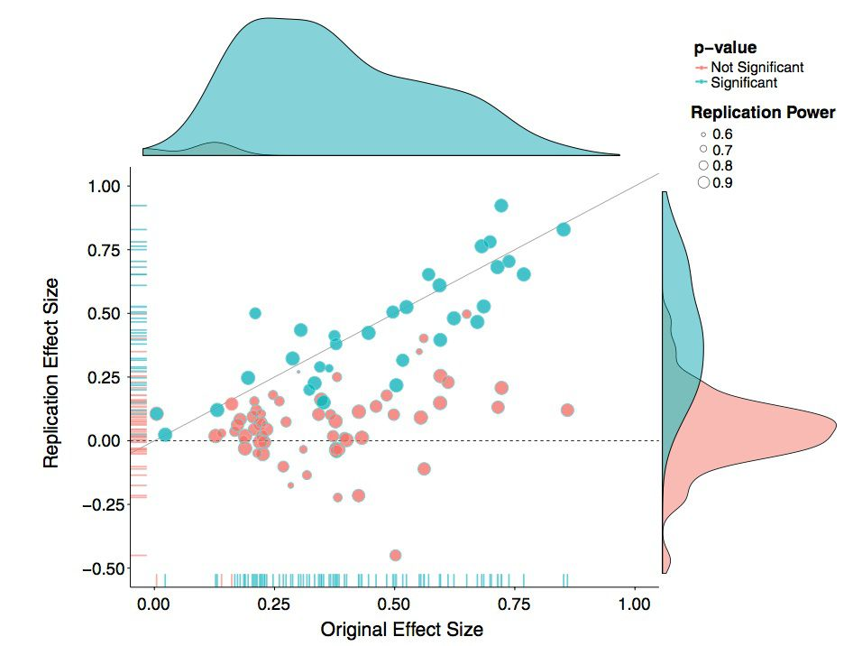
Replication of 100 psychological studies

Slide 14
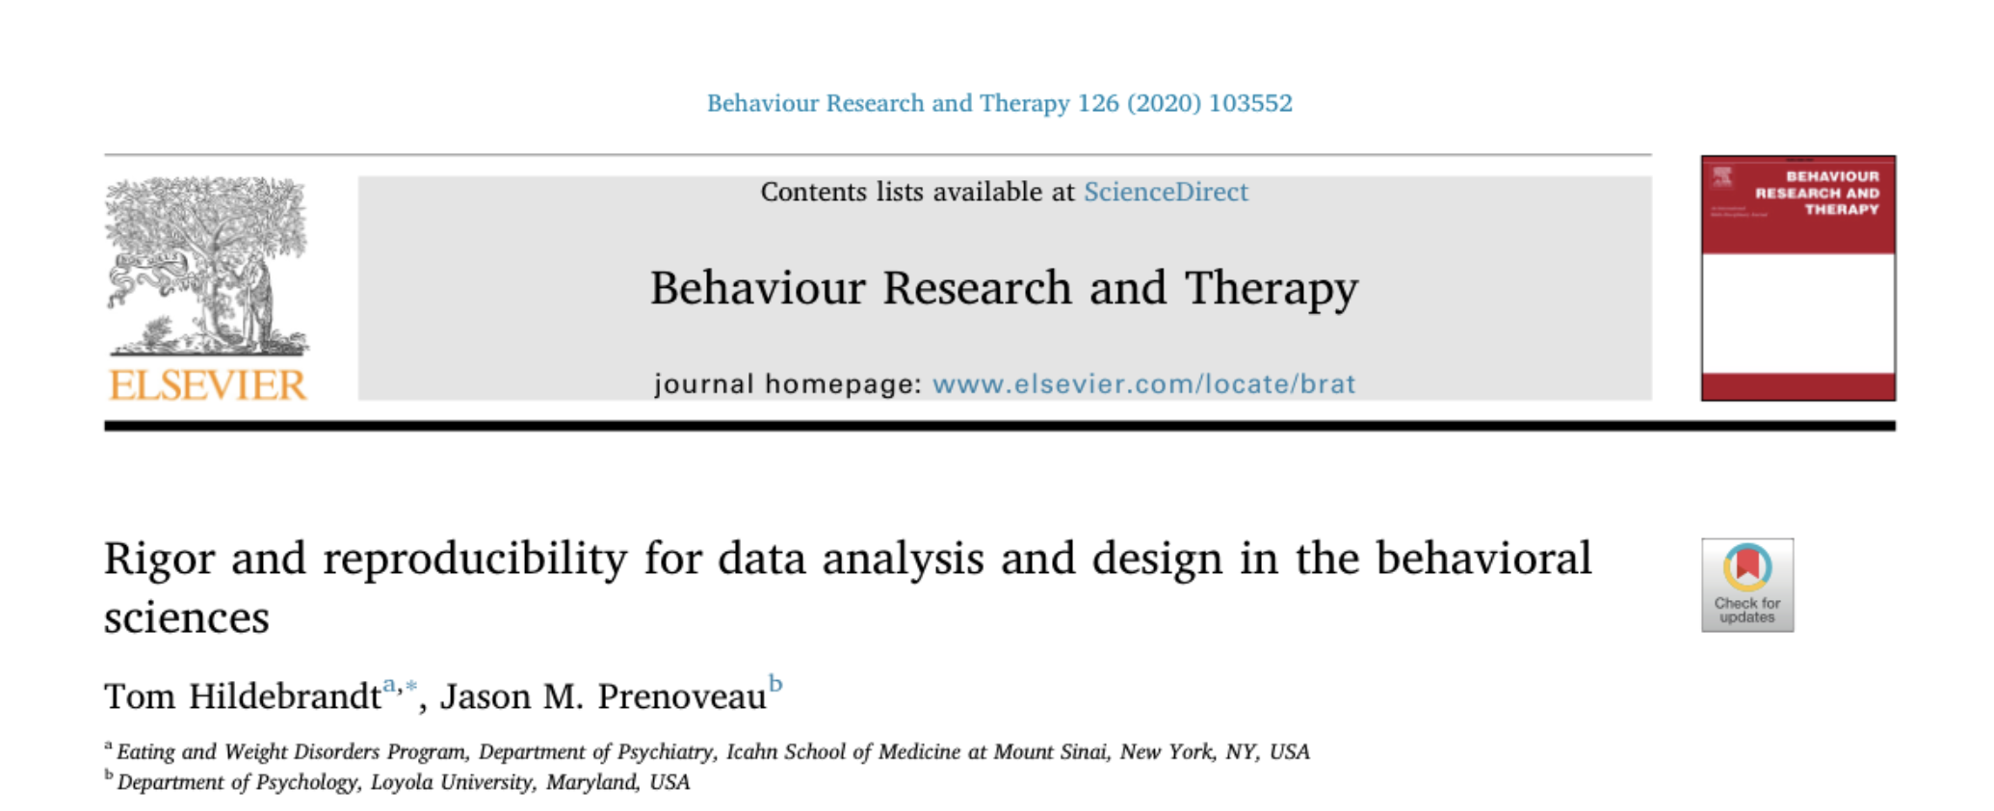
Rigor and Reproducibility Criteria
Narrative Hypotheses
Statistical Hypotheses
Pre-Registration
Start-Stop Rules
Exclusion and Inclusion
Shared Code
Power Analysis
Data Sharing

Slide 15
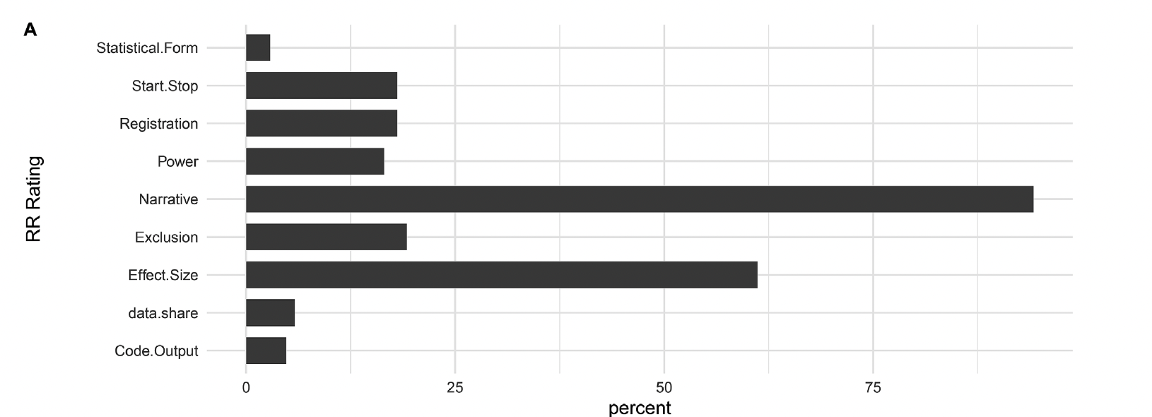
2018: Behavior Research and Therapy

Slide 16
Moving Towards Advanced OS Skills
Beginner
Intermediate
Advanced
Posting pre-prints
Pre-registration; registered reports
Curating data
Developing synthetic data
Publishing reproducible and accessible code
Use of version control repositories
Publishing comprehensive protocols
Publishing ‘open access’

Slide 17
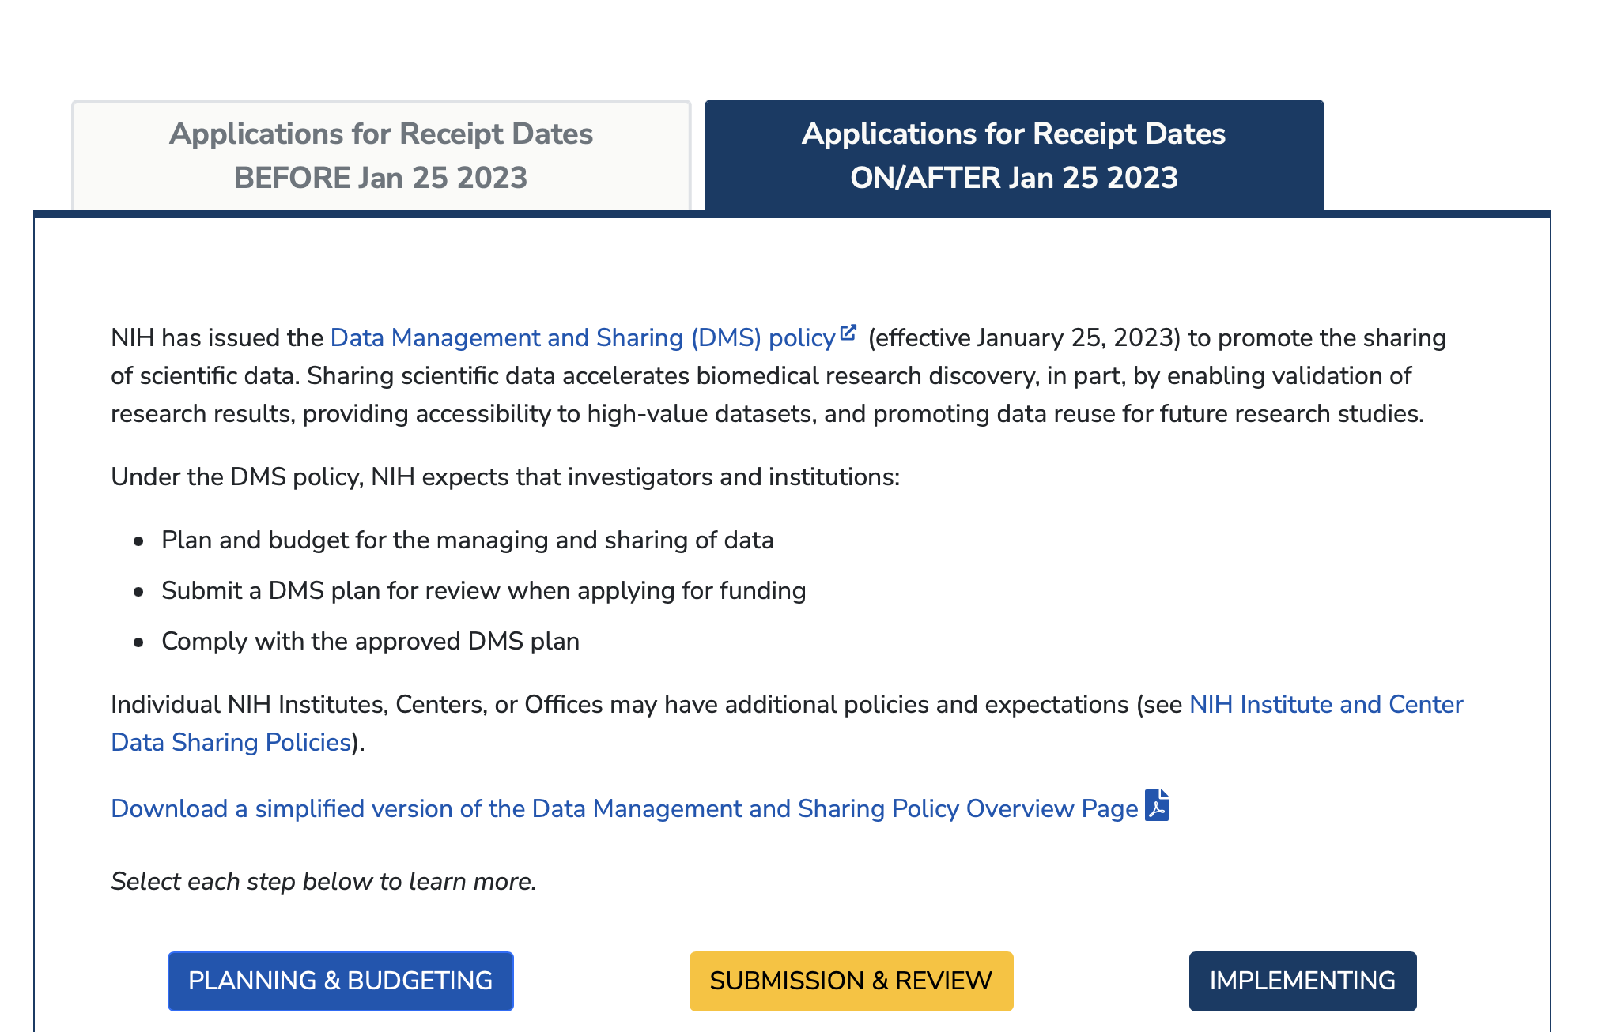

Slide 18

Find Your Why
Skills pay bills
Increasing R&R emphasis
Data Sharing Requirements
Specific funding for R&R development
Be a better collaborator
Values-aligned scientific process
Notes:
Stop here:
What are your personal motivations for OS? Any that you would add?

Slide 19
Discussion
What is your motivation to develop and hone OS skills?
What do you see as biggest challenges to OS implementation in your field?
What might be the biggest challenges for you/your lab?

Slide 20
HW (Due Fri)
Basic R refresher using the mtcars data
Use Quarto (New File/Quarto Document in R Studio)
Write five code chunks specified in the homework with accompanying descriptions interspersed throughout the chunks
Use any aids you would like without directly copying other students’ work
Drop it in the ‘Assignments’ folder in the class GitHub

Slide 21

Set-up -R/Rstudio -Quarto -Slack -Discussion Sign-ups -Groups for OSF pre-reg -Git account (if time)

